Slide 1
Lists

Slide 2
Lists are ordered sequences that can hold a variety of object types.
They use [] brackets and commas to separate objects in the list.
[1,2,3,4,5]
Lists support indexing and slicing. Lists can be nested and also have a variety of useful methods that can be called off of them.

Slide 3
Ramesh_height = 150
Suresh_height = 145
Sudesh_height = 165
Ramesh_weight = 56
Suresh_weight = 60
Sudesh_weight = 65
Height in Cm
Weight in Kgs
Age in Years
Ramesh_age = 23
Suresh_age = 46
Sudesh_age = 58

Slide 4
Height in Cm
Ramesh_height = 150
Ramesh_weight = 56
Suresh_height = 145
Suresh_weight = 60
Weight in Kgs
Sudesh_height = 165 Sudesh_weight = 65
Age in Years
How Many Variables?
.
Ramesh_age = 23
.
Suresh_age = 46
Some info
Sudesh_age = 58

Slide 5
Height in Cm
Names = [“Ramesh”, “Suresh”, “Sudesh”]
Height = [150, 145, 165]
Weight = [56, 60, 65]
Age = [23, 45, 58]
Weight in Kgs
Age in Years
.
.
Some info

Slide 6
Height in Cm
Names = [“Ramesh”, “Suresh”, “Sudesh”]
Height = [150, 145, 165]
Weight = [56, 60, 65]
Age = [23, 45, 58]
Weight in Kgs
Age in Years
Lists
.
.
Some info

Slide 7
What is a List?
A list is an ordered data structure with elements separated by comma and enclosed within square brackets.

Slide 8

What is a List?
A list is an ordered data structure with elements separated by comma and enclosed within square brackets.

Slide 9
What is a List?
A list is an ordered data structure with elements separated by comma and enclosed within square brackets.
2

Slide 10
What is a List?
A list is an ordered data structure with elements separated by comma and enclosed within square brackets.
2 3

Slide 11
What is a List?
A list is an ordered data structure with elements separated by comma and enclosed within square brackets.
2 3 4

Slide 12
What is a List?
A list is an ordered data structure with elements separated by comma and enclosed within square brackets.
2 3 4 5 6

Slide 13
What is a List?
A list is an ordered data structure with elements separated by comma and enclosed within square brackets.
2 3 4 5 6
“ordered”

Slide 14

What is a List?
A list is an ordered data structure with elements separated by comma and enclosed within square brackets.
Some examples of List -
Single Data type

Slide 15

What is a List?
A list is an ordered data structure with elements separated by comma and enclosed within square brackets.
Some examples of List -
Single Data type
Mixed Data type

Slide 16


Extracting values from a List
0 1
2 3 4
5
Index
To extract a single element
To extract a sequence of elements

Slide 17

Extracting values from a List
0 1
2 3 4
5
Index
To extract a single element
start index
end index
To extract a sequence of elements

Slide 18
Adding elements to an existing List

Slide 19
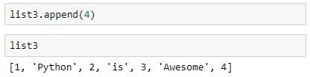
Adding elements to an existing List
Adding a single element

Slide 20
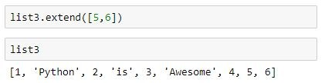
Adding elements to an existing List
Adding a single element
Adding multiple elements

Slide 21
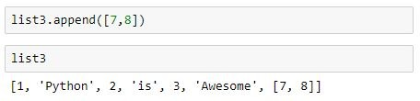
Adding elements to an existing List
Adding list to a list

Slide 22
Deleting elements of a List

Slide 23
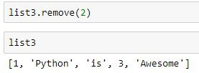
Deleting elements of a List
Deleting an element by value

Slide 24
Deleting elements of a List

Slide 25
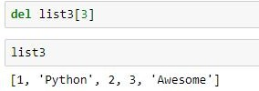
Deleting elements of a List
Deleting an element by index

Slide 26
List Data Structure: Summary
Store
Represent
Manipulate

Slide 27
List Data Structure: Summary
Store
Represent
Multiple values
Multiple data types
Manipulate

Slide 28
List Data Structure: Summary
Store
Represent
Multiple values
Multiple data types
Manipulate
Extract values
Add values (append, extend, insert)
Remove values (del, remove, pop)
Looping over values

Slide 29
List Data Structure: Summary
Store
Represent
Multiple values
Multiple data types
Ordered/Sequential
Manipulate
Extract values
Add values (append, extend, insert)
Remove values (del, remove, pop)
Looping over values

